Slide 1

What makes a book successful?
Metro College of Technology - Data Science and Application Program
Ana Clara Tupinambá Freitas
Oriented by Professor Vijay Kumar
November,2021

Slide 2
Introduction
Gutenberg press
Since the creation of the Gutenberg press the numbers of writers and readers have increased.
Change
Change of power, revolution and peace have been influenced by words.
Provide
Provide an engine for recommendation of books.

Slide 3
Business questions
Before EDA
Change of Focus from user to publisher
After EDA
Is there differences in country preferences?
Is there rating differences between group ages?
Is there difference between overall rating by genre?
Is being awarded making a difference in ratings?
Is being pert of a Series boosting the rates?
Is there a preferential Author in Countries?
Does the number of Characters impacts ratings?
Is there a difference between USA and Other Countries reading taste?
Is there reading preferences differences between group ages?
Is time of first publication impacting in how successful a book is?
Is year of publication impacting in how successful a book is?
Is being part of a Series impacting success?
Is genre impacting in success?

Slide 4
data collection, eda, cleaning, transformation and feature engineering

Slide 5
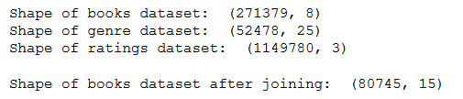
df_books
Users
User-ID
Location
Age
Ratings
User-ID
ISBN
Book-Rating
Genre
series
genres
characters
setting
firstPublishDate
awards
Book
ISBN
Book-Title
Book-Author
Year-Of-Publication
Publisher
Book-Title
Book-Author
Data Sources:
Rating, Location, Age and other attibutes: http://www2.informatik.uni-freiburg.de/~cziegler/BX/
Genre, Setting, and other attibutes: https://zenodo.org/record/4265096#.YXlibBwpCHs

Slide 6
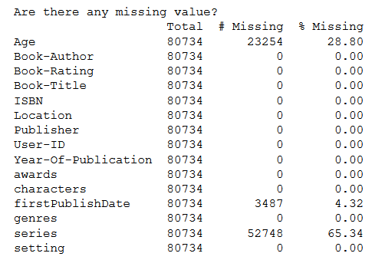
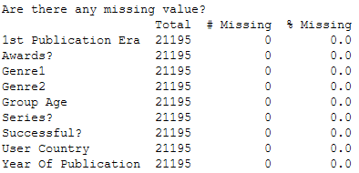
Duplicated and Missing values

Slide 7
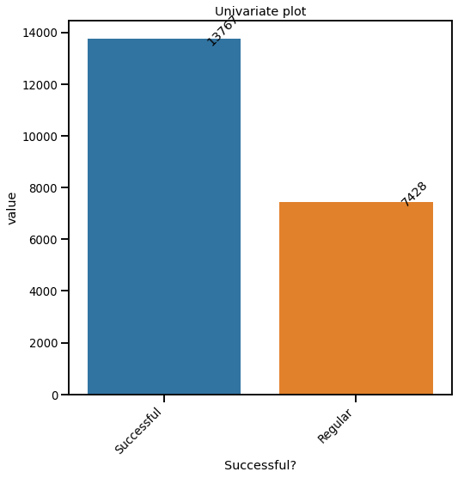
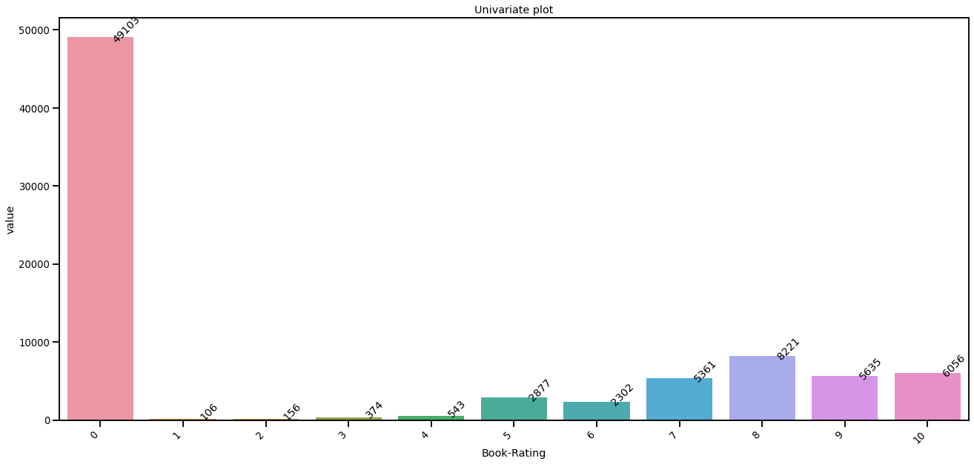
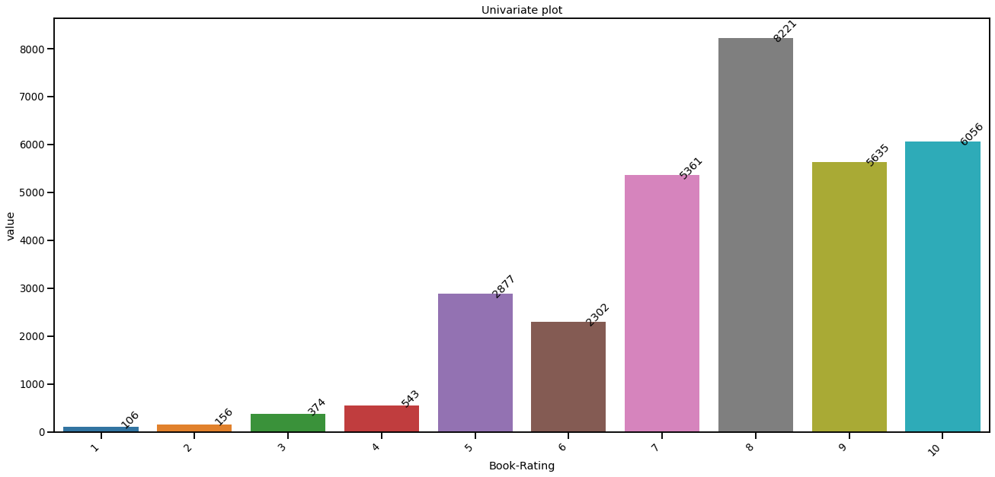

Successful?

Slide 8
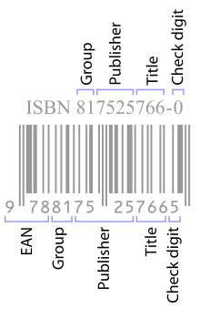
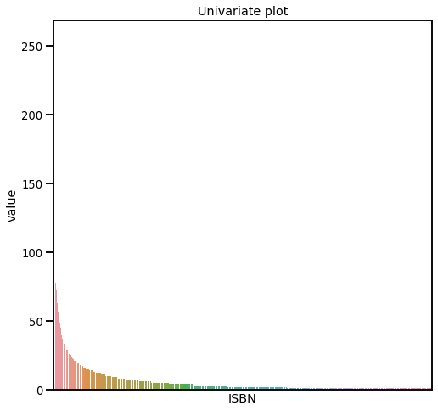
ISBN

Slide 9
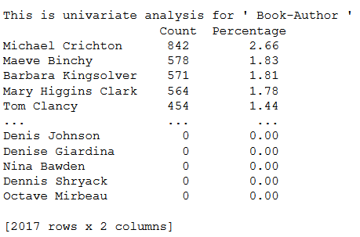
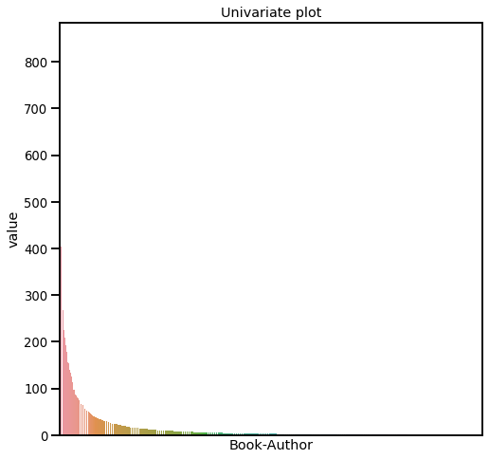
Book-AUthor

Slide 10
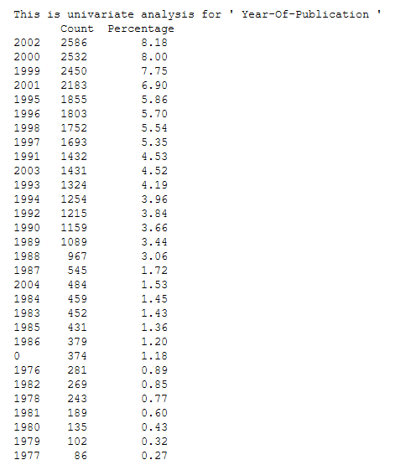
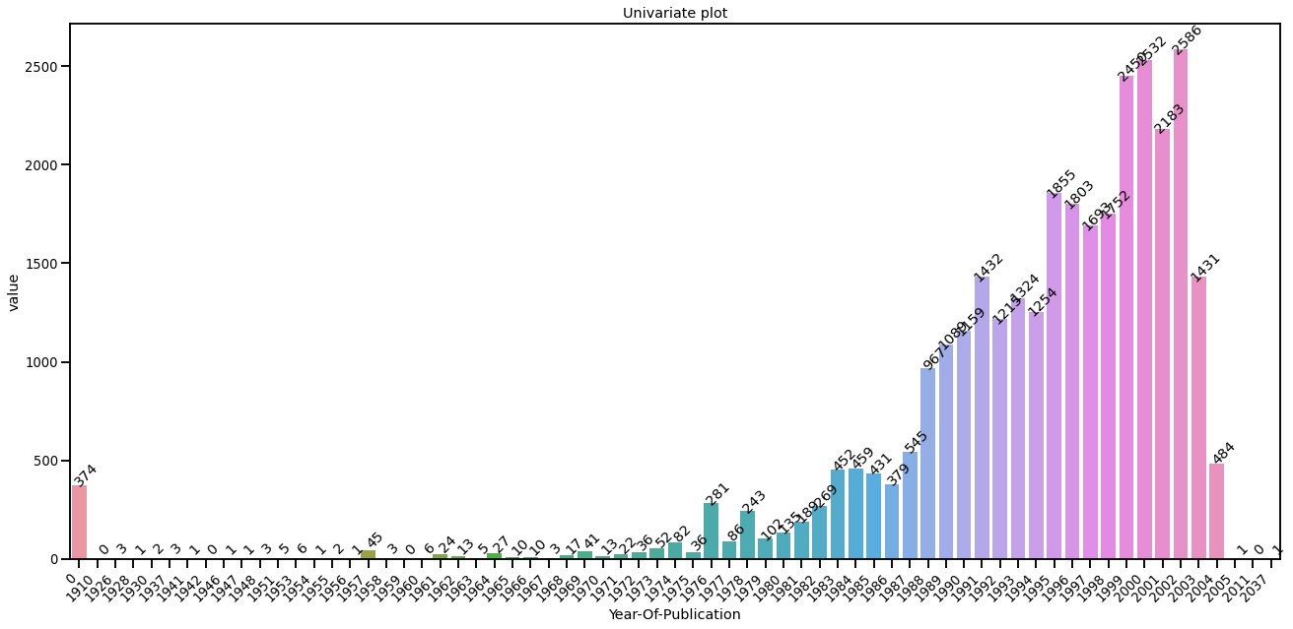
Year of Publication
First Publish Date
.
.
.
.
.
.
.
.
.

Slide 11
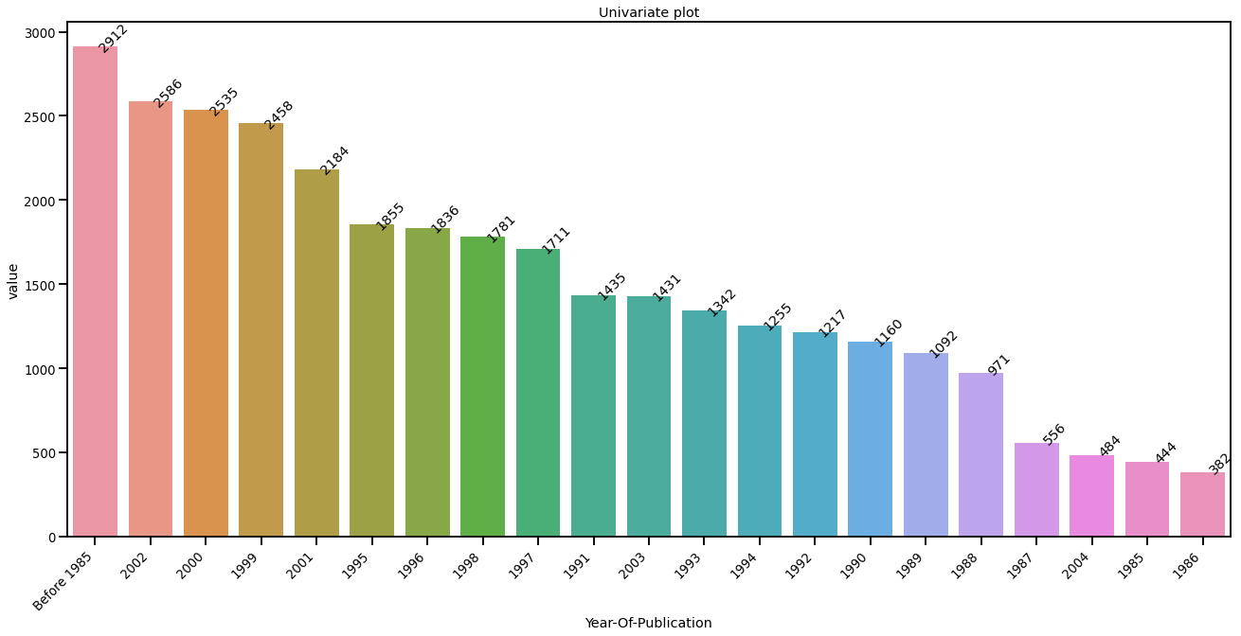
Year of Publication

Slide 12
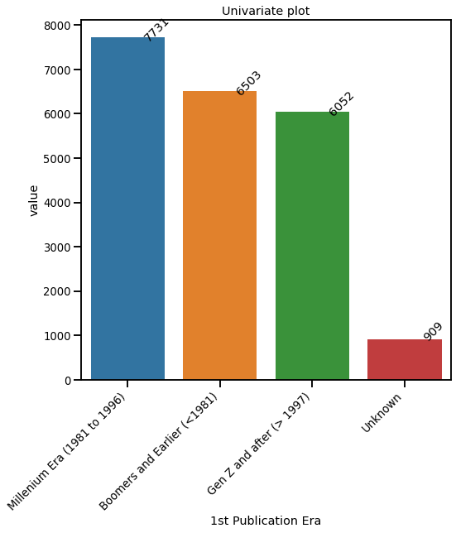
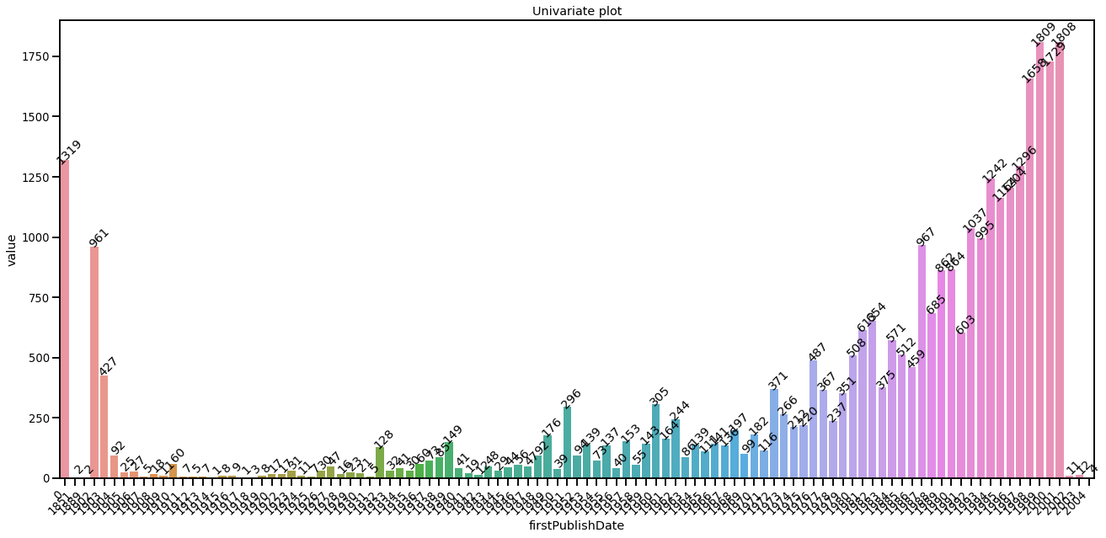
First Publication Era

Slide 13
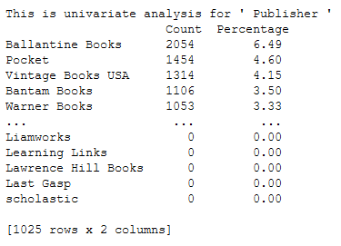
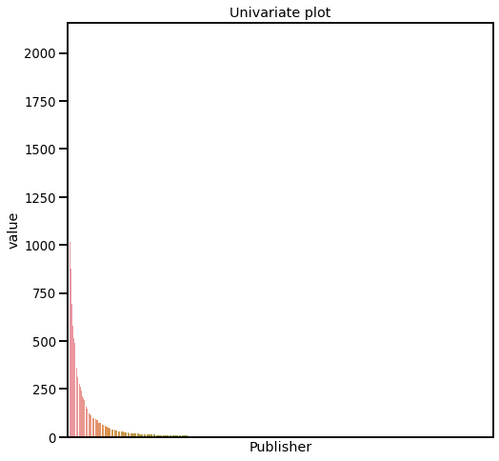
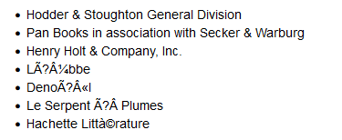
Publisher

Slide 14
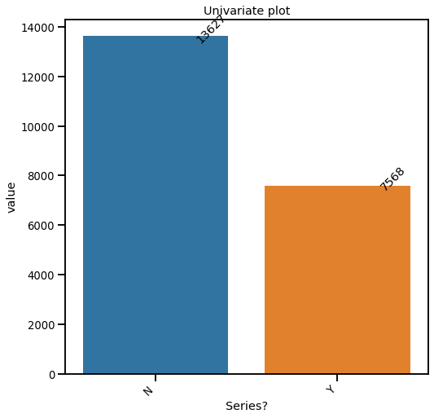
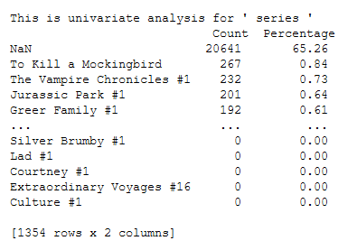

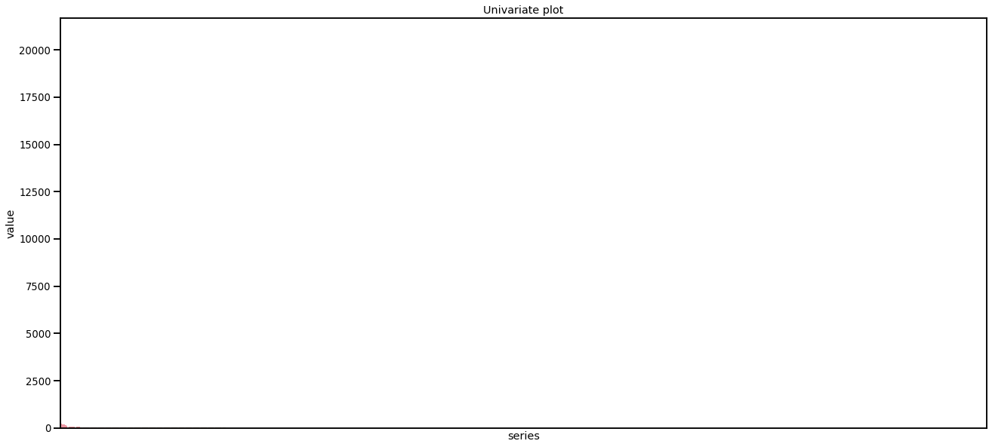

Series?

Slide 15
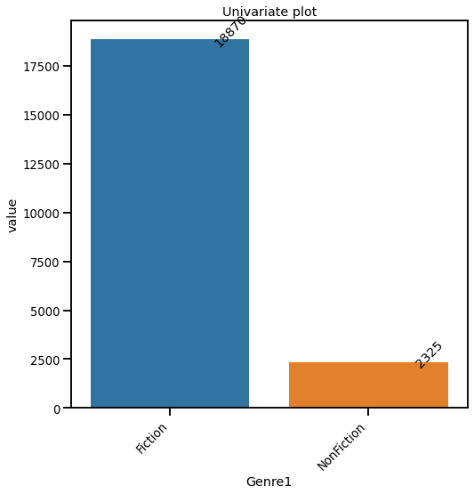
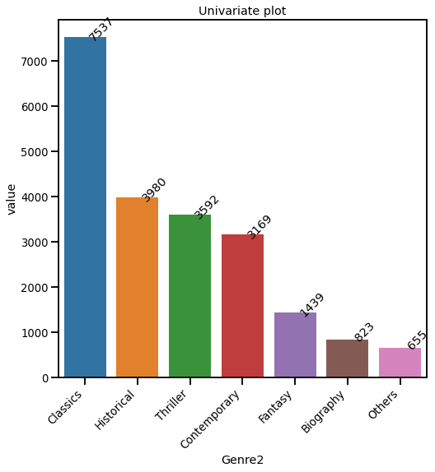
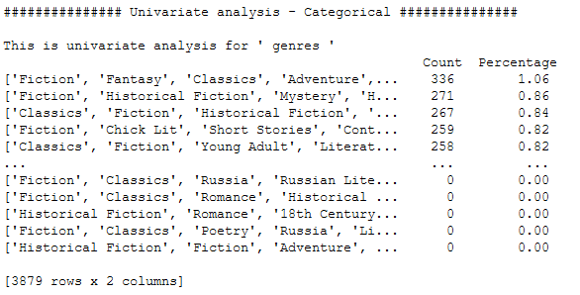
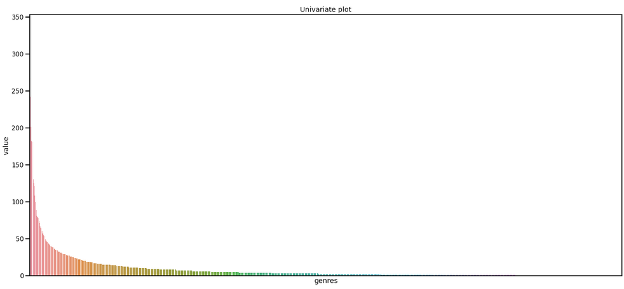
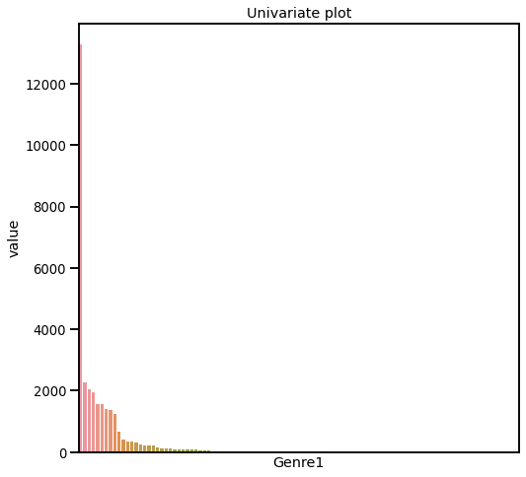
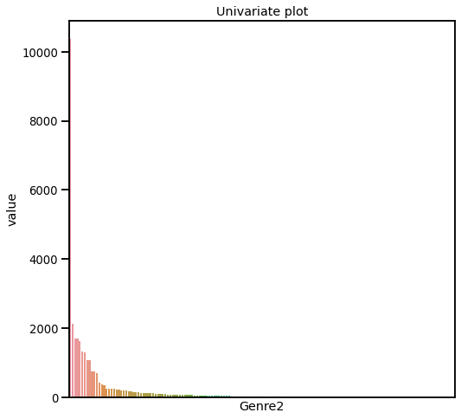
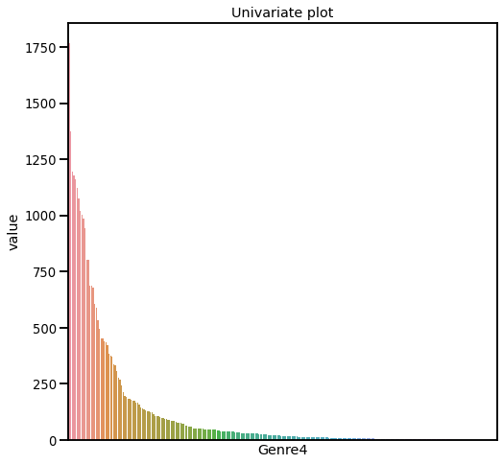
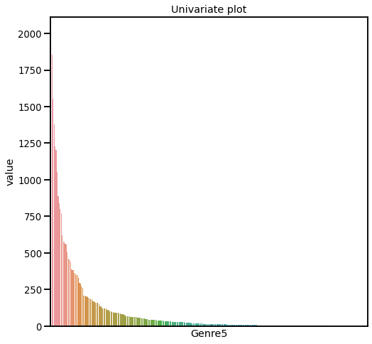
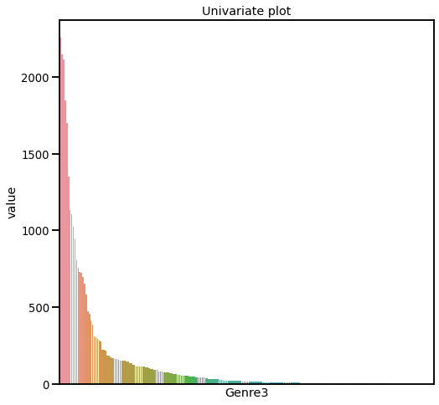
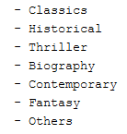
Genre1 and Genre2
…

Slide 16
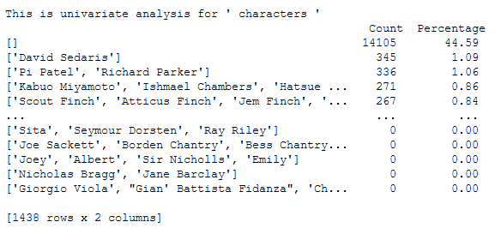
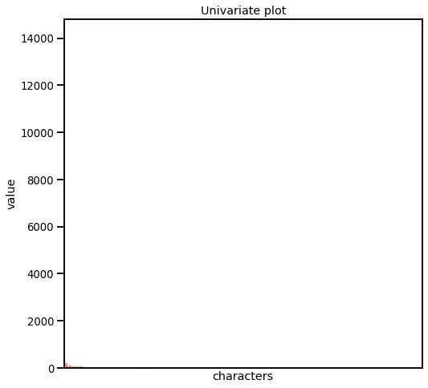
CHaracters

Slide 17
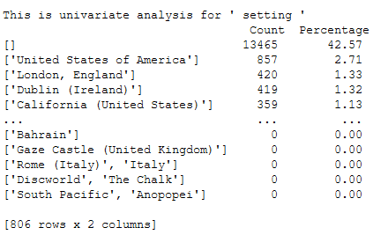
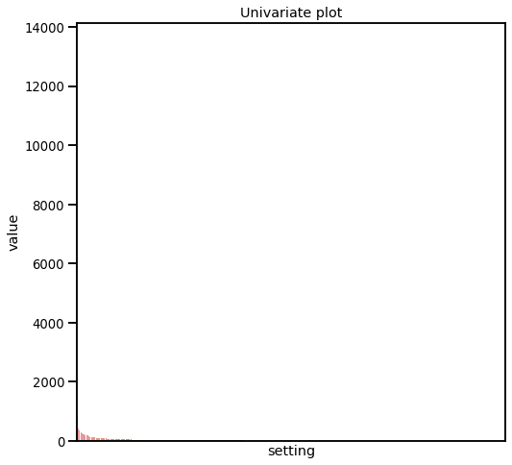
Setting

Slide 18
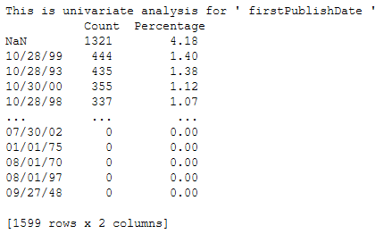
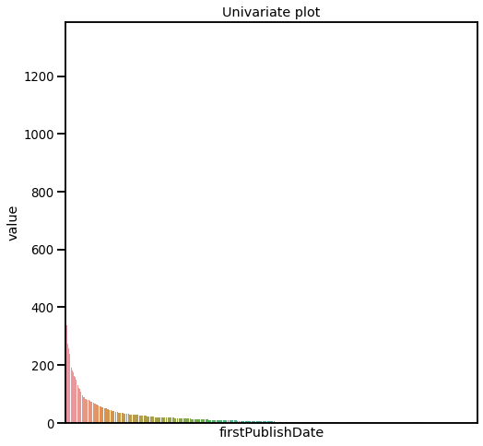
1st Publication Era

Slide 19
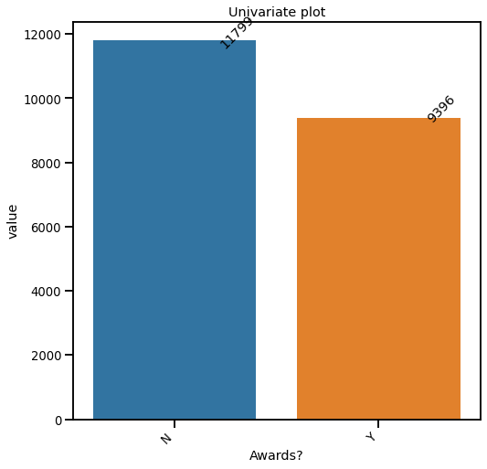
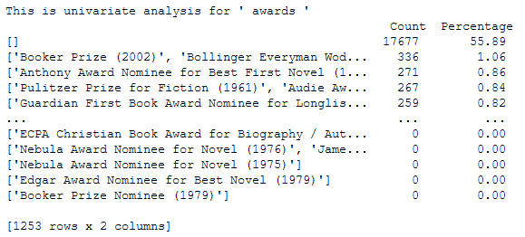

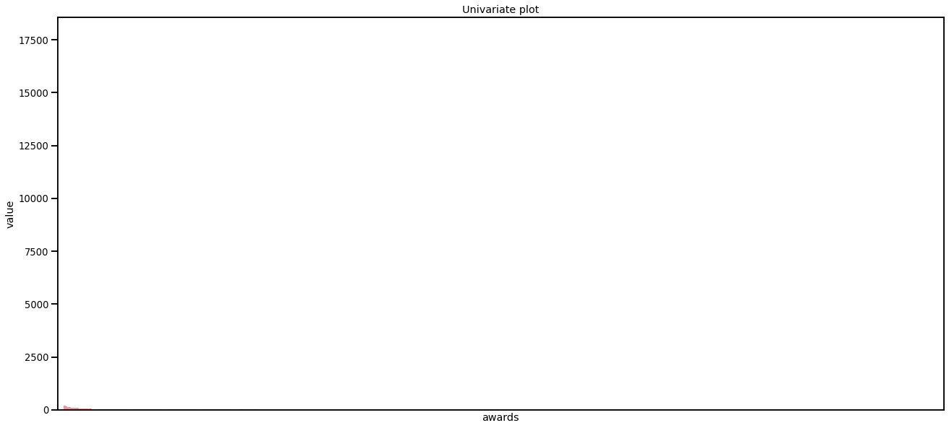
Awards?

Slide 20
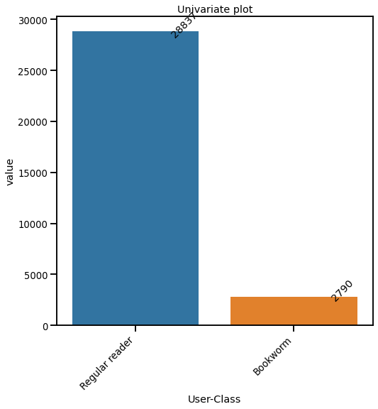
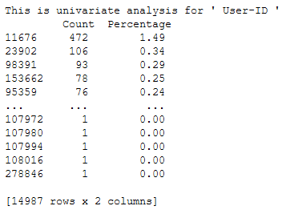
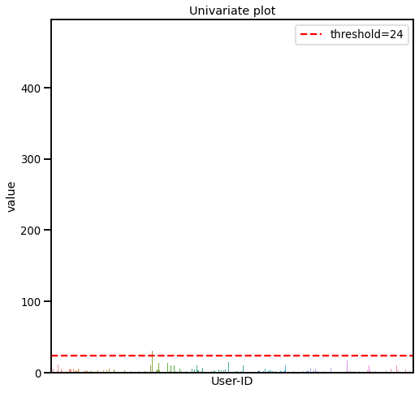
User-ID

Slide 21
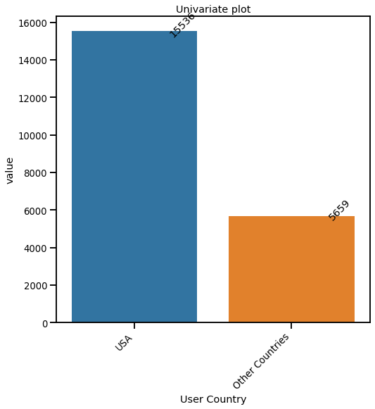
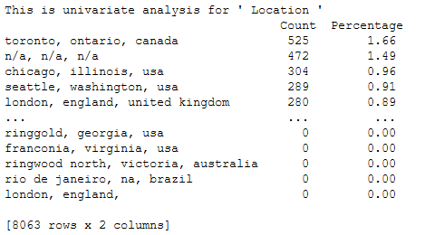
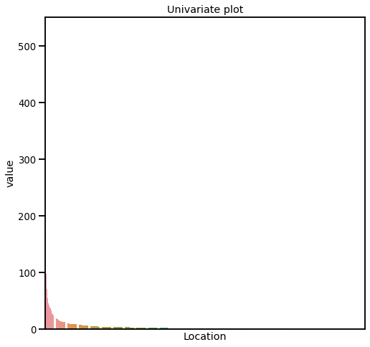
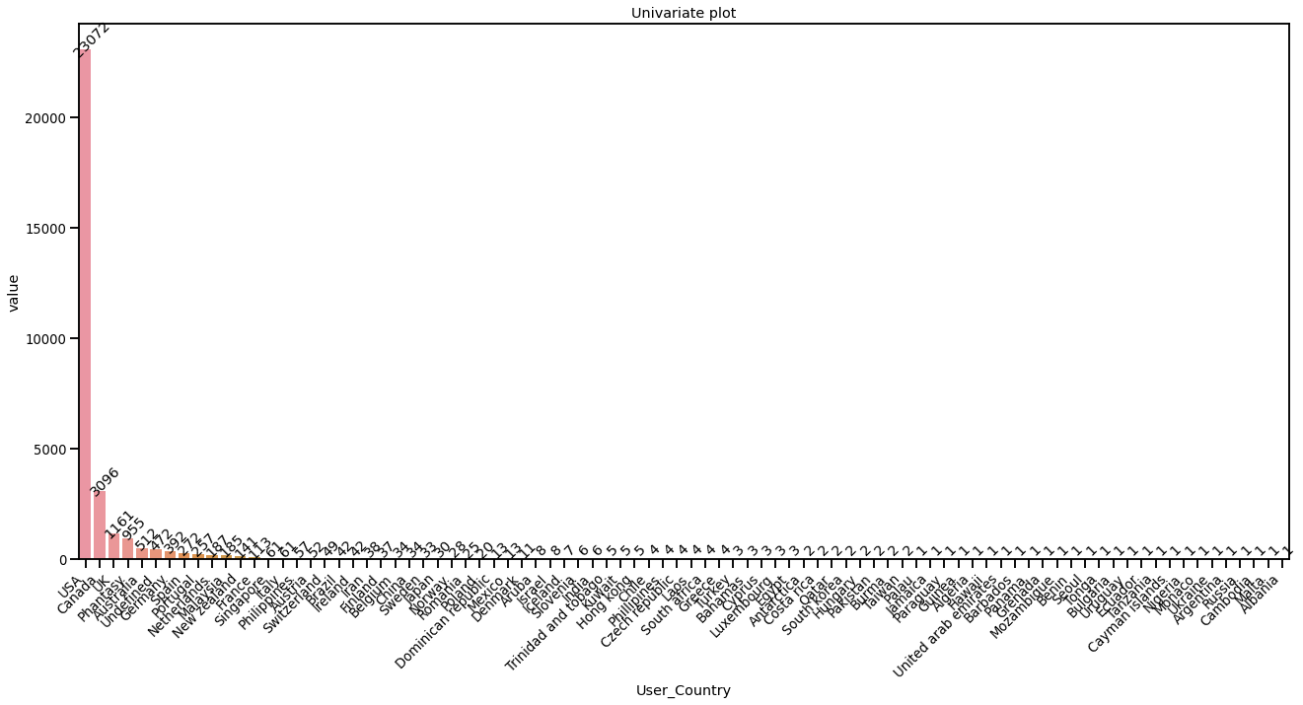
User COuntry

Slide 22
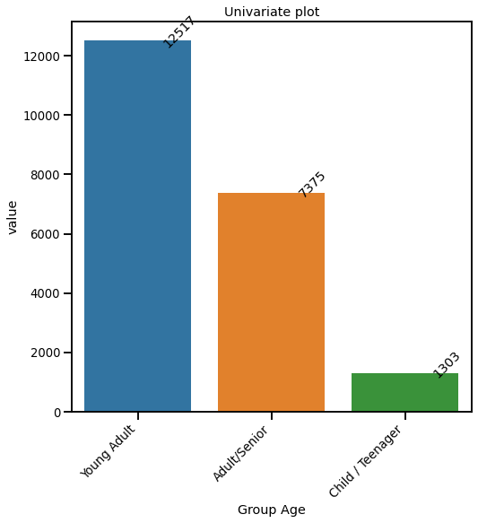
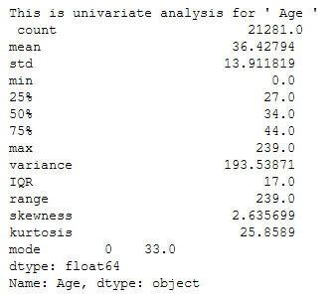
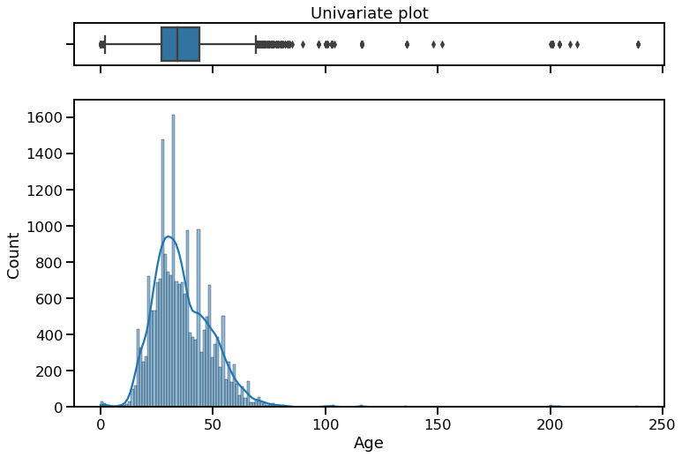

Group AGe

Slide 23
Bivariate analysis
Feature | Level | Successful? |  | p-value
 |  | Regular | Successful
Awards? | N | 4314 | 7485 | 2.33e-7
 | Y | 3114 | 6282
Genre1 | Fiction | 6753 | 12117 | 1.38e-10
 | NonFiction | 675 | 1650
Genre2 | Biography | 260 | 563 | 1.73e-46
 | Classics | 2241 | 5296
 | Contemporary | 1314 | 1855
 | Fantasy | 473 | 966
 | Historical | 1427 | 2553
 | Others | 218 | 437
 | Thriller | 1495 | 2097
Group Age | Adult/Senior | 2498 | 4877 | 7.68e-3
 | Child/Teenager | 437 | 866
 | Young Adult | 4493 | 8024
Series? | N | 4921 | 8706 | 1.36e-5
 | Y | 2507 | 5061
User Country | Other Countries | 2135 | 3524 | 8.57e-7
 | USA | 5293 | 10243

Slide 24
Feature | Level | Successful? |  | p-value
 |  | Regular | Successful
1st Publication Era | Unknown | 341 | 568 | 1.26e-19
 | Boomers and Earlier (<1981) | 2011 | 4492
 | Millenium Era (1981 to 1996) | 2720 | 5011
 | Gen Z and after (< 1997) | 2356 | 3696
Year Of Publication | Before 1985 | 604 | 1438 | 1.94e-15
 | 1985 | 96 | 199
 | 1986 | 74 | 174
 | 1987 | 127 | 256
 | 1988 | 197 | 464
 | 1989 | 197 | 509
 | 1990 | 236 | 579
 | 1991 | 374 | 617
 | 1992 | 287 | 513
 | 1993 | 295 | 622
 | 1994 | 317 | 540
 | 1995 | 442 | 788
 | 1996 | 466 | 774
 | 1997 | 405 | 699
 | 1998 | 434 | 745
 | 1999 | 610 | 1014
 | 2000 | 647 | 974
 | 2001 | 518 | 876
 | 2002 | 597 | 1034
 | 2003 | 394 | 685
 | 2004 | 111 | 267
 | 2002 | 597 | 1034
 | 2003 | 394 | 685
 | 2004 | 111 | 267

Slide 25








2.3321577048500326e-07

Slide 26
Model building and evaluation

Slide 27

1st Publication Era:
Millenium Era (1981 to 1996)
x
1st Publication Era:
Boomers and Earlier
max r = -0.5

Slide 28

GridSearchCV:
Scoring: balanced accuracy
“The balanced accuracy in binary and multiclass classification problems to deal with imbalanced datasets. It is defined as the average of recall obtained on each class.”
Source: https://scikit-learn.org/stable/modules/generated/sklearn.metrics.balanced_accuracy_score.html#sklearn.metrics.balanced_accuracy_score
Model Evaluation:
AUC
Confusion Matrix

Slide 29








Slide 30








Slide 31








Slide 32

Logistic Regression
Reference groups:
Adult/Senior
Fiction
Biography
Other Countries
Series (N)
Year of Publication
Before 1985
1st Publication Era:
Unknown

Slide 33
Conclusions
Logistic Regression is the model of choice for its simplicity and good performance in correctly classify successful books
After modeling, we can see, among other characteristics:
Books published in 2004 have the most odds of success with more than 35% compared to Before 1985
Non-Fiction have the best odds of being evaluated with almost 33% more odds than Fiction.
Young Adults are the most difficult group to please with almost 3% less odds of success than an Adult/Senior
Classics still makes the best reading having almost 25% more odds of success than a Biography.
Thriller has almost 18% odds of being successful than Biography
Recently published books have not performed well
Next steps
Increase accuracy:
Consolidate publisher to add to model
Gather more data from other countries to expand User Country feature

Slide 34

Thank you!
Questions?

